Slide 1
Foundations of Data Quality!

Slide 2
Data Quality Defined
Data quality refers to the condition of a set of values of qualitative or quantitative variables.
There are many definitions of data quality but data is generally considered high quality if it:
"fits for [its] intended uses in operations, decision making and planning".
- Wikipedia

Slide 3
Data Quality (Cont’d)
Data quality helps you to:
  Plan and prioritize data
  Parse data
  Standardize, correct and normalize data
  Verify and validate data accuracy
  Apply business rules
Standardize and Transform Data
The three components that ensure the quality and integrity of the data:
  Data rationalization
  Data standardization
  Data transformation

Slide 4
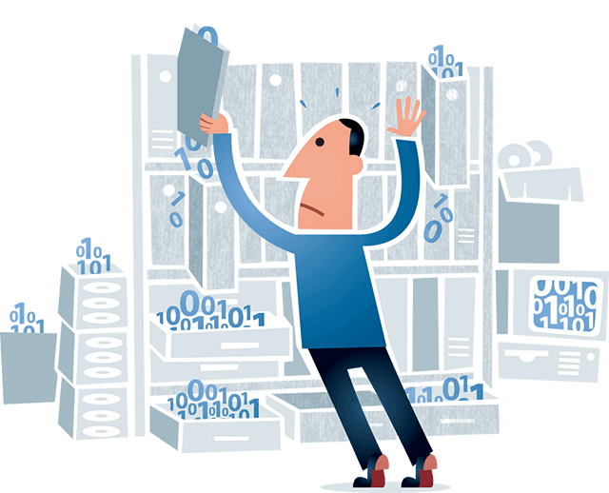
Data Quality in Data Integration
Building a unified view of the database from the information.
An effective data integration strategy can lower costs and improve productivity by ensuring the consistency, accuracy and reliability of data.
Data integration enables to:
  Match, link and consolidate multiple data sources
  Gain access to the right data sources at the right time
  Deliver high-quality information
  Increase the quality of information

Slide 5
Data Quality Dimensions
Accuracy: Degree to which data correctly reflects the real world or a surrogate source
Correctness: Degree to which reported information values conform with the true or accepted values (Fitness)
Consistency/Validity:
  Degree to which data is synchronized across all sources
  Degree of freedom from variation or contradiction
  Degree of satisfaction of constraints (including syntax/format/semantics)

Slide 6
Data Quality Dimensions
Completeness/Brevity:
  Degree to which expected records are present, and data attributes are populated
  Degree to which duplicate entities are identified and appropriately resolved
  Degree to which values not needed for decision making are excluded
Time/Utility; Degree to which currentness of data values renders them useful
Pedigree/Lineage/Provenance: History of data origin and subsequent ownership and transformation for traceability
Precision/Certainty:
  Level of detail or exactness (significant digits, rounding, truncation, resolution, sampling rate, etc.)
  Confidence in value (vs. imprecise, approximate, uncertain, probabilistic, or fuzzy)

Slide 7



















































Causes of Bad Data Quality
DURING PROCESS OF
EXTRACTION
DATA DECAY DURING LOADING AND ARCHIVING
Initial Conversion of Data
Consolidation of System
Manual Data Entry
Batch Feeds
Real Time Interfaces
Changes Not Captured
System Upgrades
Use of New Data
Loss of Expertise
Automation Process
Effect of Bad Quality
DURING DATA TRANSFORMATIONS
Processing Data
Data Scrubbing
Data Purging

Slide 8
DQAF– Data Quality Assessment Framework
A descriptive taxonomy of measurement types designed to help people measure the quality of their data and use measurement results to manage data.
      Conceptual and technology-independent (i.e., it is not a tool)
      Generic – it can be applied to any data
Initially defined in 2009 by a multi-disciplinary team from Optum and UHC seeking to establish an effective approach for ongoing measurement of data quality. Basis for Measuring Data Quality for Ongoing Improvement.
    Focuses on objective characteristics of data within five quality dimensions:
      Completeness
      Timeliness
      Validity
      Consistency
      Integrity
    Defines measurement types that
      Measure characteristics important to most uses of data (i.e., related to the basic meaning of the data)
      Represent a reasonable level of IT stewardship of data. That is, types that enable data management.

Slide 9
Using the DQAF
The different kinds of assessment are related to each other.
      Initial assessment drives the process by separating data that meets expectations from data that does not and helping identify at risk and critical data for ongoing measurement.
      Monitoring and periodic measurement identify data that may cease to meet expectations and data for which there are improvement opportunities.
  The concept of data quality dimensions provides the initial organizing principle behind the DQAF:
  Data Quality Dimension: A data quality dimension is a general, measurable category for a distinctive characteristic (quality) possessed by data. Data quality dimensions function in the way that length, width, and height function to express the size of a physical object. They allow understanding of quality in relation to a scale and in relation to other data measured against the same scale. Data quality dimensions can be used to define expectations (the standards against which to measure) for the quality of a desired dataset, as well as to measure the condition of an existing dataset. Dimensions provide an understanding of why we measure. For example, to understand the level of completeness, validity, and integrity of data.

Slide 10
DQAF Terminology
Measurement Type:
      Within the DQAF, a measurement type is a subcategory of a dimension of data quality that allows for a repeatable pattern of measurement to be executed against any data that fits the criteria required by the type, regardless of specific data content.
      The measurement results of a particular measurement type can be stored in the same data structure regardless of the data content.
      Measurement types describe how measurement are taken, including what data to collect, what comparisons to make, and how to identify anomalies. For example, all measurements of validity can be executed in the same way. Regardless of specific content, validity measurements include collection of data and comparison of values to a specified domain.
Specific Metric:
      A specific metric describes data that is measured and the way in which it is measured.
      Specific metrics describe what is measured. For example, a metric to measure the validity of procedure codes on a medical claim table. Or one to measure the validity of ZIP codes on a customer address table.

Slide 11
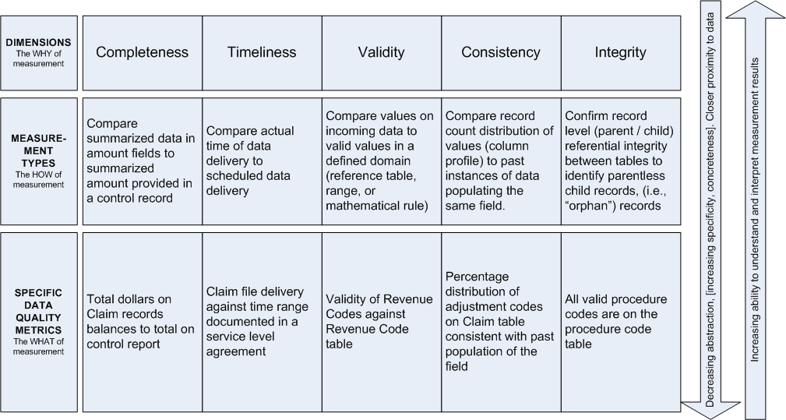
For Example… IMF declarations!
Notes:
Dimensions, Measurement Types, Specific Metrics. The figure illustrates the relationship between data quality dimensions, DQAF measurement types, and specific data quality metrics. Dimensions are central to most discussions about data quality. They describe aspects of data quality that can be measured and provide the why of measurement. Measurement types are central to the DQAF. Describe generic ways to measure the dimensions –the how of measurement. They bridge the distance between dimensions and specific measurements which describe what particular data will be measured – the what of measurement.

Slide 12
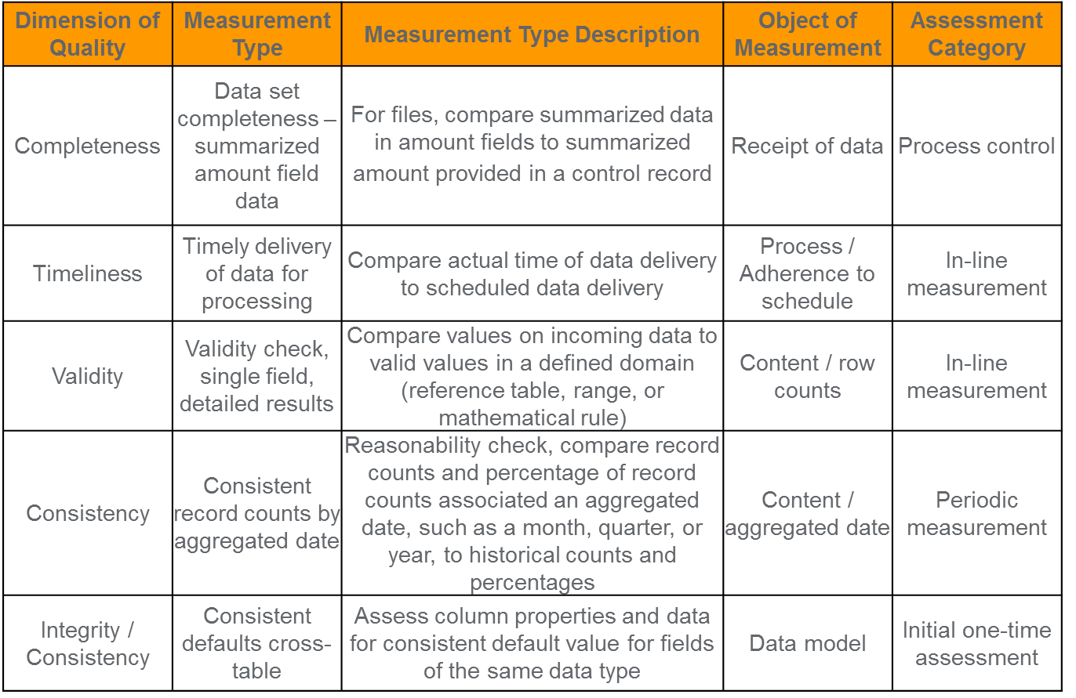
Example (cont’d)

Slide 13
DQAF Dimensions
Completeness: Completeness is a dimension of data quality. As used in the DQAF, completeness implies having all the necessary or appropriate parts; being entire, finished, total. A data set is compete to the degree that it contains required attributes and a sufficient number of records, and to the degree attributes are populated in accord with data consumer expectations. For data to be complete, at least three conditions must be met: the data set must be defined so that it includes all the attributes desired (width); the data set must contain the desired amount of data (depth); and the attributes must be populated to the extent desired (density). Each of these secondary dimensions of completeness would be measured differently.
Timeliness: Timeliness is a dimension of data quality related to the availability and currency of data. As used in the DQAF, timeliness is associated data delivery, availability, and processing. Timeliness is the degree to which data conforms to a schedule for being updated and made available. For data to be timely, it must be delivered according to schedule.
Validity: Validity is a dimension of data quality, defined as the degree to which data conforms to stated rules. As used in the DQAF, validity is differentiated from both accuracy, and correctness. Validity is degree to which data conform to a set of business rules, sometimes expressed as a standard or represented within a defined data domain.
Consistency: A dimension of data quality. As used in the DQAF, consistency can be thought of as the absence of variety or change. Consistency is the degree to which data conform to an equivalent set of data, usually a set produced under similar conditions or a set produced by the same process over time.
Integrity: Integrity is a dimension of data quality. As used in the DQAF, integrity refers to the state of being whole and undivided or the condition of being unified. Integrity is degree to which data conform to data relationship rules (as defined by the data model) that are intended to ensure the complete, consistent, and valid presentation of data representing the same concepts. Integrity represents the internal consistency of a data set.
Notes:
I will not read these slides. Will only reference them.

Slide 14
DQAF Terminology
Assessment Category:
      In the DQAF, an assessment category is a way of grouping measurement types based on where in the data life cycle the assessment is likely to be taken.
      Assessment categories pertain to both the frequency of the measurement (periodic or in-line) and the type of assessment involved (control, measurement, assessment).
      They include initial assessment, process control, in-line measurement, periodic measurement, and periodic assessment.
Measurement (or Assessment) Activities:
      Measurement activities describe the goals and related actions related associated with work carried out within an assessment category. Measurement activities differ depending on when, within the data lifecycle, they are carried out and against which the objects of measurement.
      Measurement activities correspond closely with DQAF measurement types.
Object of Measurement:
      In the DQAF, objects of measurement are groupings of measurement types based on whether types focus on process or content, or on a particular part of a process (e.g., receipt of data) or kind of content (e.g., the data model).
      Content-related objects of measurement include: The data model, content based on row counts, content of amount fields, date content, aggregated date content, summarized content, cross-table content (row counts, aggregated dates, amount fields, chronology), overall database content.
      Process-related objects of measurement include: Receipt of data, Condition of data upon receipt, adherence to schedule, data processing

Slide 15
Context of Data Quality Assessment

Slide 16
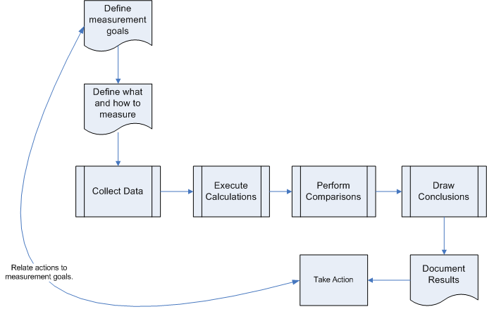
Functions in Assessment: Collect, Calculate, Compare, Conclude
Use DQAF dimensions to help with this process
and measurement types to help with this process

Slide 17
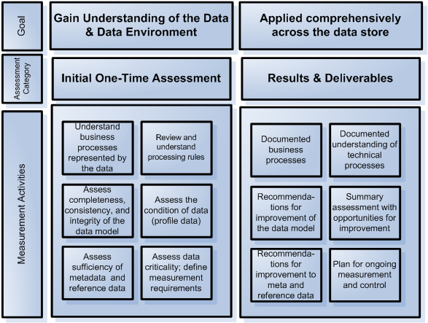
Initial Assessment

Slide 18
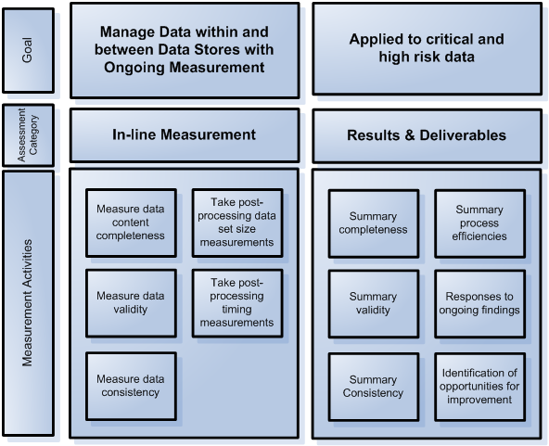
In-Line Measurement & Control

Slide 19
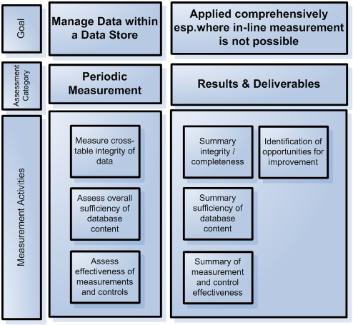
Periodic Measurement

Slide 20
Data Quality Dimensions for Distributed Data Systems
DIMENSIONS
Accuracy - they measure what they are intended to measure
Completeness - collected comprehensively
Reliability - repeated measurements using the same procedures get the same results
Timeliness - up-to-date & available on time
Confidentiality - clients’ data are not disseminated
Precision - have sufficient detail to use for decision making
Integrity - protected from bias or manipulation
Validity - considered accurate—they measure what they are intended to measure
Timeliness - means that the data are sufficiently current and frequent to inform management’s decision making. They are received by the established deadline.
Completeness - Comprehensive data collection; percentage of all fields in the data collection form filled in; percentage of all expected reports received.
Big compute cannot occur everywhere given resource constraints;
Data quality should be applied to available information to ensure that data elements and indicators in the system can produce quality data modelling;

Slide 21
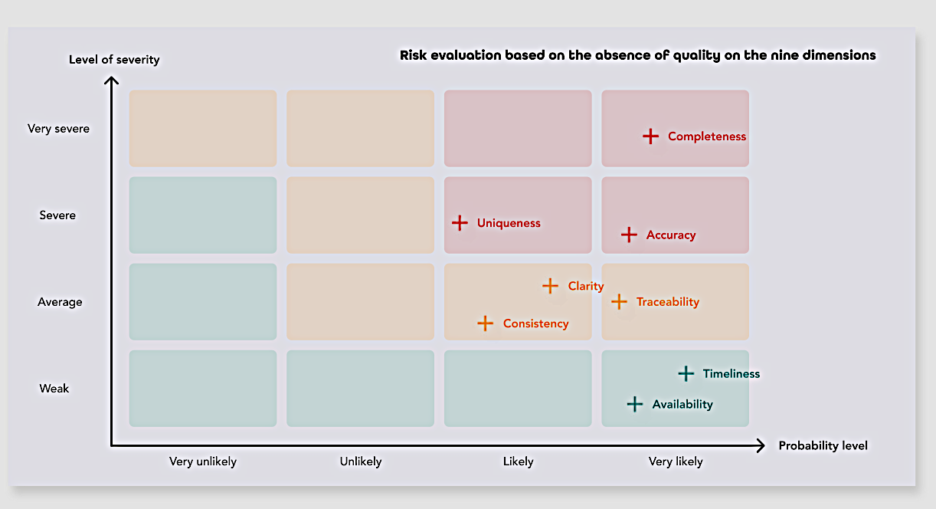

Slide 22
Data Quality Problems
Single Source Problems
Multi-Source Problems
Schema Level
(lack of integrity constraints,
poor schema design)
Uniqueness
Referential Integrity
Instance Level
(Data entry errors)
Misspellings
Redundancy/duplicates
Contradictory values
Schema Level
(heterogeneous data models and schema designs)
Naming Conflicts
Structural Conflicts
Instance Level
(overlapping, inconsistent,
contradicting data)
Inconsistent aggregating
Inconsistent timing
Notes:
The data quality of a source largely depends on the degree to which it is governed by schema and integrity constraints controlling permissable data values. For sources without schema, such as files, there are few restrictions on what data can be entered and stored, giving rise to a high probability of errors and inconsistencies. Database systems, on the other hand, enforce restrictions of a specific data model (e.g., the relational approach requires simple attribute values, referential integrity, etc.) as well as application-specific integrity constraints. Schema-related data quality problems thus occur because of the lack of appropriate model-specific or application-specific integrity constraints, e.g., due to data model limitations or poor schema design, or because only a few integrity constraints were defined to limit the overhead for integrity control. Instance-specific problems relate to errors and inconsistencies that cannot be prevented at the schema level (e.g., misspellings).
Naming conflicts arise when the same name is used for different objects (homonyms) or different names are used for the same object (synonyms). Structural conflicts occur in many variations and refer to different representations of the same object in different sources, e.g., attribute vs. table representation, different component structure, different data types, different integrity constraints, etc.
In addition to schema-level conflicts, many conflicts appear only at the instance level (data conflicts). All problems from the single-source case can occur with different representations in different sources (e.g., duplicated records, contradicting records,…). Furthermore, even when there are the same attribute names and data types, there may be different value representations (e.g., for marital status) or different interpretation of the values (e.g., measurement units Dollar vs. Euro) across sources. Moreover, information in the sources may be provided at different aggregation levels (e.g., sales per product vs. sales per product group) or refer to different points in time (e.g. current sales as of yesterday for source 1 vs. as of last week for source 2).
A main problem for cleaning data from multiple sources is to identify overlapping data, in particular matching records referring to the same real-world entity (e.g., customer).

Slide 23
Single Source Problems
Schema level

Slide 24
Single Source Problems
Instance level

Slide 25
Multi-Source Problems
Notes:
The two sources in the example are both in relational format but exhibit schema and data conflicts. At the schema level, there are name conflicts (synonyms Customer/Client, Cid/Cno, Sex/Gender) and structural conflicts (different representations for names and addresses). At the instance level, we note that there are different gender representations (“0”/”1” vs. “F”/”M”) and presumably a duplicate record (Kristen Smith). The latter observation also reveals that while Cid/Cno are both source-specific identifiers, their contents are not comparable between the sources; different numbers (11/493) may refer to the same person while different persons can have the same number (24). Solving these problems requires both schema integration and data cleaning; the third table shows a possible solution. Note that the schema conflicts should be resolved first to allow data cleaning, in particular detection of duplicates based on a uniform representation of names and addresses, and matching of the Gender/Sex values.

Slide 26
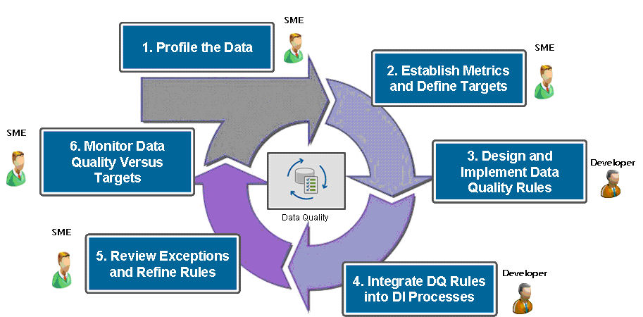
A Data Quality Methodology
Source: https://tdwi.org/Articles/2009/01/28/Data-Quality-Management-Getting-More-from-Your-BI-Investment.aspx?Page=5
Notes:
Improving data quality must be approached as an ongoing cycle. To start, data profiling (1) is a key element in scoping overall data quality initiatives—it enables you to determine the content, structure, and quality of highly complex data structures and to discover hidden inconsistencies and incompatibilities between data sources and target applications. Establishing metrics and defining targets (2) helps IT and the business measure the results of data quality efforts as part of a BI initiative. Design and implementation of data quality rules (3) help define and measure targets and criteria for data quality. Integrating data quality rules and activities (profiling, cleansing/matching, automated remediation, and management) with data integration processes (4) is critical to enhancing the accuracy and value of data assets.

Slide 27
Revise the scope
of the problem
Step 1: Review Decision Problem
OR
Transform or otherwise modify the data
Step 2: Learn more about the data
OR
Data Quality Assessment Steps
Step 3: Select the statistical method
Choose a new statistical test
Do the assumptions hold?
No
Step 4: Verify the assumptions of the method
Step 5: Draw conclusions
Yes
Product/decision
Notes:
EXPLAIN:
DQA is an iterative process. Often you'll need to revisit earlier steps if you run into a problem in a later step.
The figure which shows one example of where iteration might occur.
Step 4 in particular is one place you might run into a stopping point if your data doesn't meet the assumptions needed for the test you selected. There are many options for what to do at that point, some are shown here and will be discussed in greater detail in later sessions.
This figure shows the list of three possible actions you might take if the assumptions do not hold.

Slide 28

ETL stands for Extract-Transform-Load and it is a process of how data is loaded from source systems to the data warehouse.
  Data is extracted from an OLTP database, transformed to match the data warehouse schema and loaded into the data warehouse database. Many data warehouses also incorporate data from non-OLTP systems such as text files, legacy systems and spreadsheets.
The role of the Extraction, Transformation and Loading process is to define a single, detailed, comprehensive and high-quality data source that can in turn feed the DW (Reconciliation)
During the process of feeding the DW, reconciliation occurs in two occasions: when the DW is first populated, and periodically when the DW is updated.
  Extraction
  Cleansing
  Transformation
  Upload

Slide 29




Extraction
Operational and
external Data
Relevant data is extracted from the sources.
  Static extraction is carried out when the DW is to be populated for the first time and consists conceptually in a snapshot of the operational data.
  Incremental extraction is used for periodic updating of the DW, and only captures changes in sources that have occurred since the last extraction
The choice of the data to be extracted is mainly based on their quality and relevance to the requirements.
Extraction
Cleaning
Transformation
Loading
Data Warehouse

Slide 30
Cleaning
Operational and
external Data
Responsible for improving the quality of the data collected from sources
  duplicate data
  inconsistencies between logically associated values
  missing data
  Unintended use of a field
  Impossible or incorrect values
  inconsistent values for the same entity due to different conventions
  inconsistent values for the same entity due to typing errors
Extraction
Cleaning
Transformation
Loading
Data Warehouse

Slide 31
Transformation
Operational and
external Data
Converts data from the source operational format to the DW format. Correspondence with the source layer is complicated by the presence of heterogeneous sources, which require a complex integration phase
  presence of free-form texts that hide important information
  use of different formats for the same data
In particular, the following steps are carried out in order to be able to feed the reconciled data:
  conversion and normalization (operate at the level of the format of storage and units of measure to standardize the data)
  matching (establishes matches between equivalent fields in different sources)
  selection (reduces the number of fields and records compared to the sources)
Extraction
Cleaning
Transformation
Loading
Data Warehouse

Slide 32
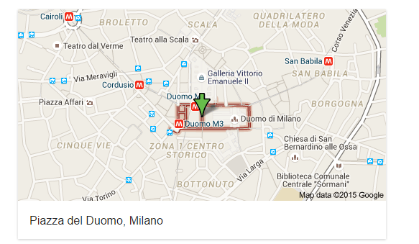
Cleaning and Transformation: Example
Carlo Bianchi
P.zza Duomo 1
43121 Milano (I)
nome: Carlo
cognome: Bianchi
indirizzo: P.zza Duomo 1
CAP: 43121
città: Milano
nazione: I
Normalization
nome: Carlo
cognome: Bianchi
indirizzo: Piazza Duomo 1
CAP: 43121
città: Milano
nazione: Italia
Standardization
nome: Carlo
cognome: Bianchi
indirizzo: Piazza Duomo 1
CAP: 20121
città: Milano
nazione: Italia
Correction

Slide 33
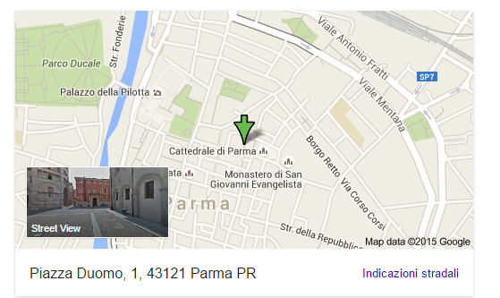
Cleaning and Transformation: Example
Carlo Bianchi
P.zza Duomo 1
43121 Milano (I)
nome: Carlo
cognome: Bianchi
indirizzo: P.zza Duomo 1
CAP: 43121
città: Milano
nazione: I
Normalization
nome: Carlo
cognome: Bianchi
indirizzo: Piazza Duomo 1
CAP: 43121
città: Milano
nazione: Italia
Standardization
nome: Carlo
cognome: Bianchi
indirizzo: Piazza Duomo 1
CAP: 43121
città: Parma
nazione: Italia
Correction

Slide 34

Loading
Operational and
external Data
Loading data into the DW:
  Refresh: the data of the DW are entirely rewritten, replacing the previous ones
    Method that is usually used only to initially populate the DW
  Update: only changes in the source data are added to the DW
    Method normally used for the periodic updating of the DW
Extraction
Cleaning
Transformation
Loading
Data Warehouse

Slide 35
ETL or ELT?
Extraction →Load→ Transformation
  Suggested mainly by ORACLE
ELT (Extract, Load, Transform) is a variant of ETL wherein the extracted data is first loaded into the target system. Transformations are performed after the data is loaded into the data warehouse.
ELT typically works well when the target system is powerful enough to handle transformations.
Advantages
  All operations in the same DBMS (No staging system involved)
  Faster loading
Disadvantages
  Less flexible
  Ties the process to the DBMS
https://www.guru99.com/etl-vs-elt.html

Slide 36
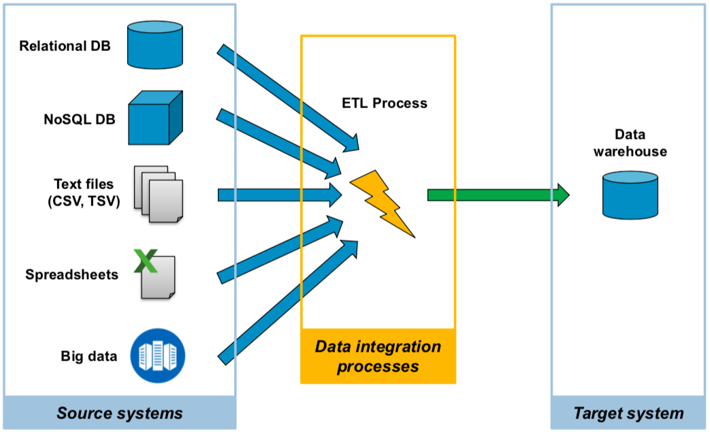
Tools
How to implement data integration processes?
Two main alternatives:
Writing ad-hoc programs
  SQL Scripts
  Stored procedures
  Shell Scripts
  Programs written in general purposed programming languages (e.g., Java and Python)
Data Integration specific tools
  Enable the implementation of data handling processes (jobs) from one or more sources to one or more destinations
  Visual flow programming (drag-and-drop and ready-to-use component configuration)

Slide 37
Tools
How to implement data integration processes?
Two main alternatives:
Writing ad-hoc programs
  SQL Scripts
  Stored procedures
  Shell Scripts
  Programs written in general purposed programming languages (e.g., Java and Python)
Data Integration specific tools
  Enable the implementation of data handling processes (jobs) from one or more sources to one or more destinations
  Visual flow programming (drag-and-drop and ready-to-use component configuration)
MAP-REDUCE!

Slide 38
Commercial
  IBM
  Oracle
  Informatica
  DataRobot
  MathWorks
  …
Open-source
  Talend open studio
  Penthao Kettle
  UnifiedViews
  NIFI
  AIRFLOW
  LUIGI
  …

Slide 39
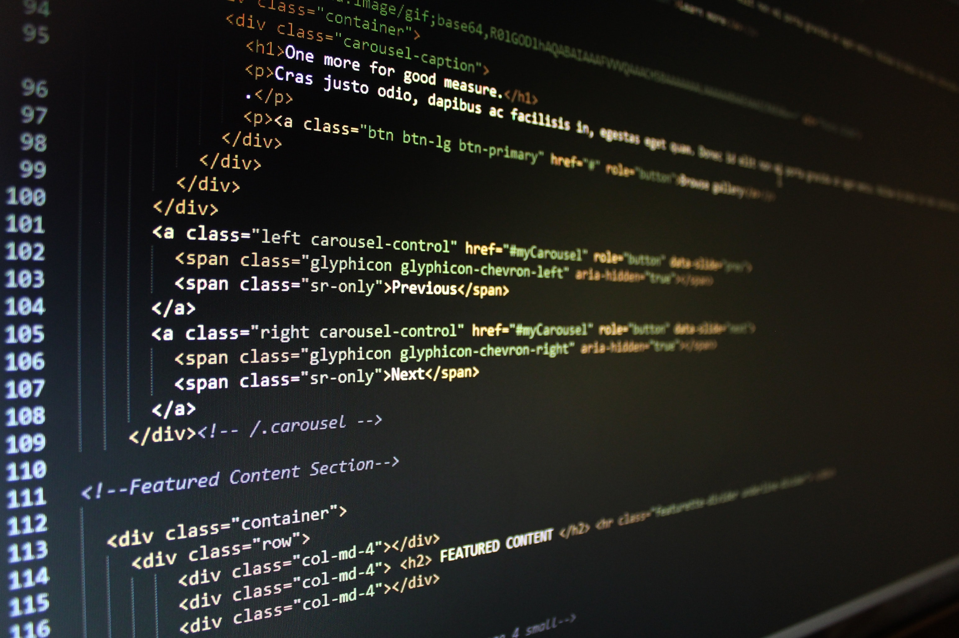
Ad-Hoc solutions
Advantages:
  High flexibility: total control over code and data transformations
  Fine-tuning possibilities for better performance
  No need to learn new tools
  No license fees
Disadvantages
  Reduced maintainability: the logic of the flow is often not very evident (it is in the programmer's head)
  Lack of reusable components for extraction, loading and processing operations
  Often low performance, if you do not know in depth the mechanisms behind the language used
  Difficult to schedule and coordinate processes (workflow)
  Difficult to monitor execution (logging/auditing)

Slide 40
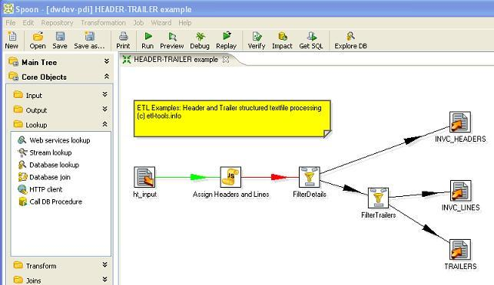
ETL tools
Generally structured in:
Set of components for access to external sources
  Access to files, relational DBs, big data, ...
  Both for reading (extraction) and writing (loading)
Set of components for transforming the stream of records
  Join, Filter, Lookup, ...
Visual job designer
  Allows you to draw the flow by connecting and configuring the necessary components appropriately
Engine of execution of the designed processes
  Allows to run the processes
  A distributed execution environment is often supported
Monitoring and control tools
  Scheduling, logging, error management, alerting, ...

Slide 41
ELT tools
Advantages:
  Visual design of jobs: the logic of the data flow is explicit and evident (self-documenting)
  Reusable components for data extraction, transformation and loading
  Explicit support for the typical operations needed to feed a data-mart
  Tracking of metadata and data origin (data lineage: where it comes from and how the data is transformed)
  Consolidated tools for coordinating and scheduling processes
  Effective tools for monitoring execution (logging/auditing)
Disadvantages
  Reduced flexibility: depends very much on the instrument chosen and on the quantity and configurability of the transformation components supplied
  Possible licensing and technical support costs
  Difficulty in fine-tuning to improve performance

Slide 42
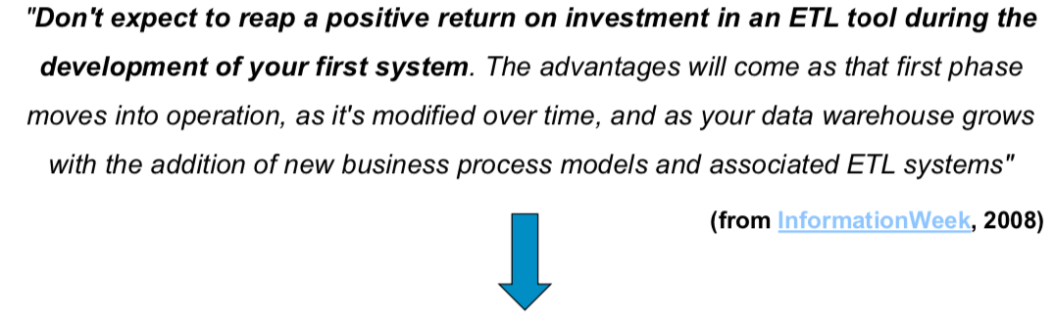
Which approach to use?
«Should you use an ETL tool? Yes.
Do you have to use an ETL tool? No!»
Cit. Kimball
For simple processes, you don't need too sophisticated tools;
If the process is complex, it is necessary to approach it with tools up to the task.
The advantages of using an ETL tool are only evident with increasing process complexity

Slide 43
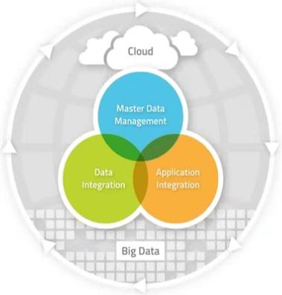
Tool Example: Talend
Solutions for the management of "traditional" and big data
Open source products Licensed add-ons and enterprise support
Consulting and training services
Products distributed under Apache v2 license

Slide 44
Talend Open Studio for Data Integration
Provides:
  900+ data transformation components and connection to external sources
  Job designer for visual modeling of transformation processes
  Support for visual modeling of Business Models (abstract level data flow, business-oriented)
  Multi-lingual support
What the enterprise version adds:
  Development and collaboration tool for the team
  Tools for administration and monitoring of job execution
  Metadata management
  Technical support via web and e-mail

Slide 45
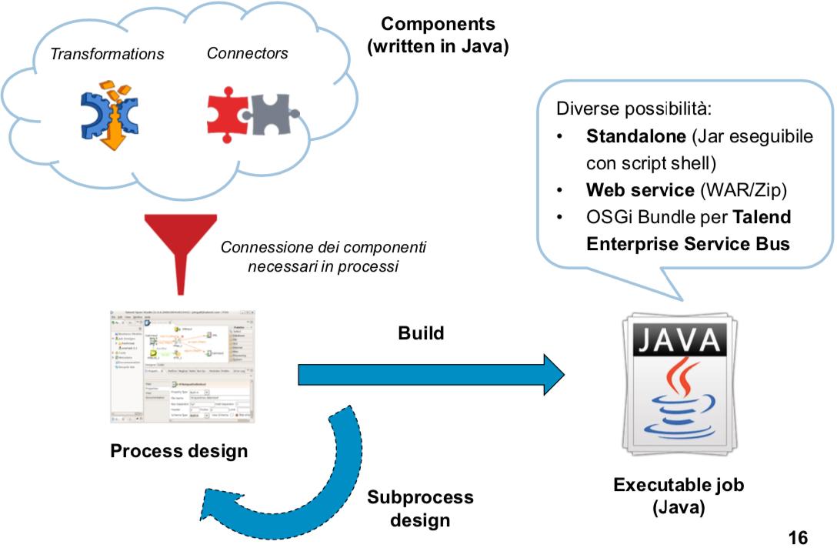
Talend Open Studio for Data Integration
Different possibilities:
Standalone (Jar executable with shell script)
Web service (WAR/Zip)
OSGi Bundle for Talend Enterprise Service Bus
Connecting the necessary components in processes

Slide 46
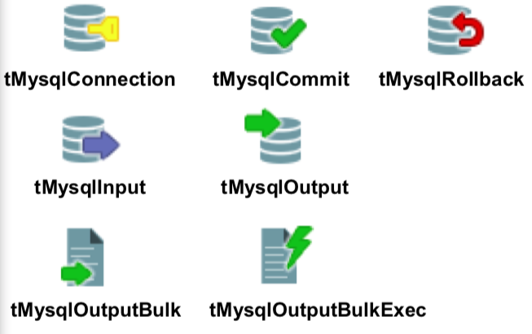
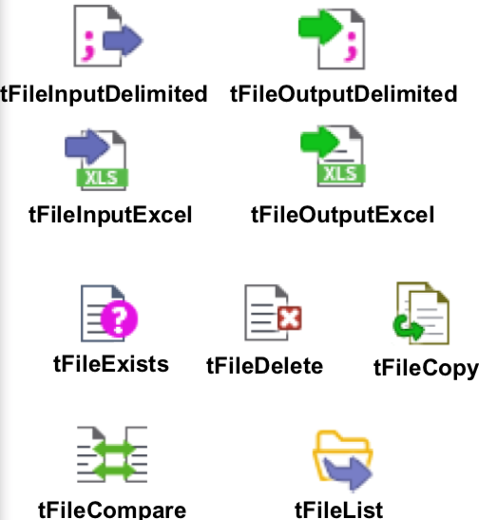
Talend Open Studio for DI: some components
Access to relational DBs
  The following are the components for MySQL, but there are for the most common DBMS, and generic JDBC components
  Opening of DB connections and transaction control
  Read (SQL SELECT) and write (SQL INSERT/UPDATE/DELETE) tuples in MySQL
  Loading of bulk tuples (more efficient than performing single INSERT)
File manipulation
  Reading and writing delimited files (CSV/TSV)
  Reading and writing Excel files
  Verify the existence of a file, delete and copy files
  Diff between files and reading the contents of a directory

Slide 47
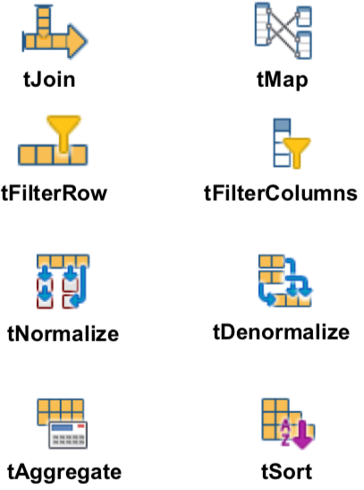
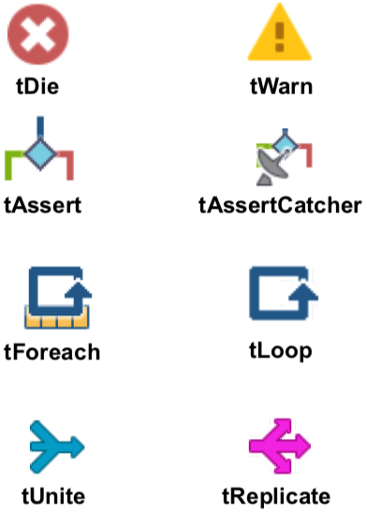
Talend Open Studio for DI: some components
Process control
  Raising fatal errors (with process interruption) and warnings
  Definition of assertions for the control of the process status
  Iterative execution of components and sub-processes
Transformation and aggregation
  Join (lookup) data into a reference and mapping stream between multiple stream schemes
  Filtration of the tuples of a stream according to a condition, and filtering of the selected columns
  Normalization and denormalization of a data stream
  Aggregation and sorting

Slide 48

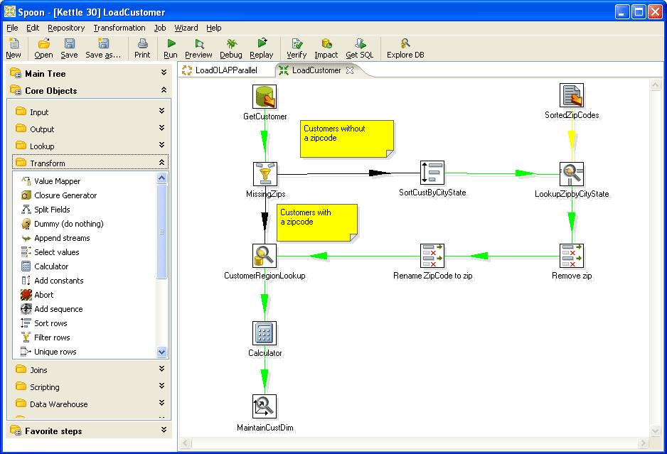
Re: Status update: (Aanvraag niet-standaard werkplek / of accessoires) Melding nummer M22053684

Slide 49
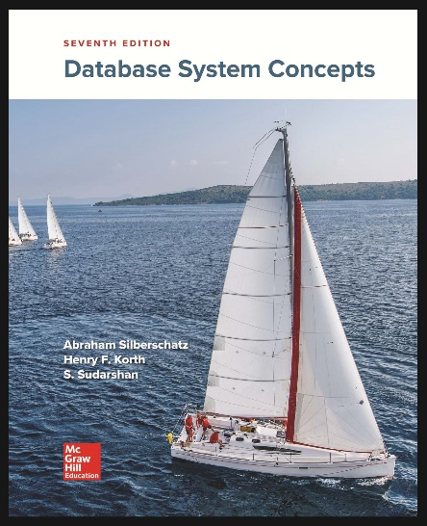
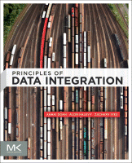
References
https://www.sciencedirect.com/book/9780124160446/principles-of-data-integration
The students should be able to download this book with a Tu/e account (e.g., at JADS or using VPN)

Slide 50
References
[1] Roland Bouman, Trends in Data Warehouse Data Modeling: Data Vault and Anchor Modeling, http://www.percona.com/files/presentations/percona-live/london-2011/PLUK2011-trends-in-data-warehouse-data-modeling-data-vault-and-anchor-modeling.pdf
[2] Dan Linstedt, Data Vault Basics, http://danlinstedt.com/about/data-vault-basics/
[3] Tony Brown, Data Warehouse Implementation with the SAS® System, SAS Institute Inc., Dallas, TX, http://www2.sas.com/proceedings/sugi22/DATAWARE/PAPER132.PDF
[4] Matteo Golfarelli, Stefano Rizzi, A Survey on Temporal Data Warehousing, International Journal of Data Warehousing & Mining, 5(1), 1-17, January-March 2009
[5] Slides Prof. Stefano Rizzi (http://www-db.deis.unibo.it/~srizzi/) e il Dott. Angelo Sironi
[6] Kimball Group, Articles & Papers, http://www.kimballgroup.com/html/articles.html

Slide 51
References
[7] Claudia Imhoff e al., Mastering Data Warehouse Design: Relational and Dimensional Techniques, Wiley Publishing, Inc., 2003
[8] H.J. Watson & T. Ariyachandra, Data Warehouse Architectures: Factors in the Selection Decision and the Success of the Architectures, 2005 (http://www.terry.uga.edu/~hwatson/DW_Architecture_Report.pdf )
[9] William H. Inmon, Building the Data Warehouse, Fourth Edition, Wiley Publishing Inc., 2005
[10] R. Kimball & M. Ross, The Data Warehosue Tollkit, Second Edition, Wiley Publishing Inc., 2002

Slide 52
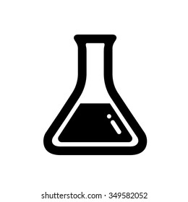
LAB SESSION:
Data Quality in ACTION

Slide 53
Noon Session
STEP-1:
Find an online dataset here → https://datasetsearch.research.google.com/
Notes:
Show interactively

Slide 54
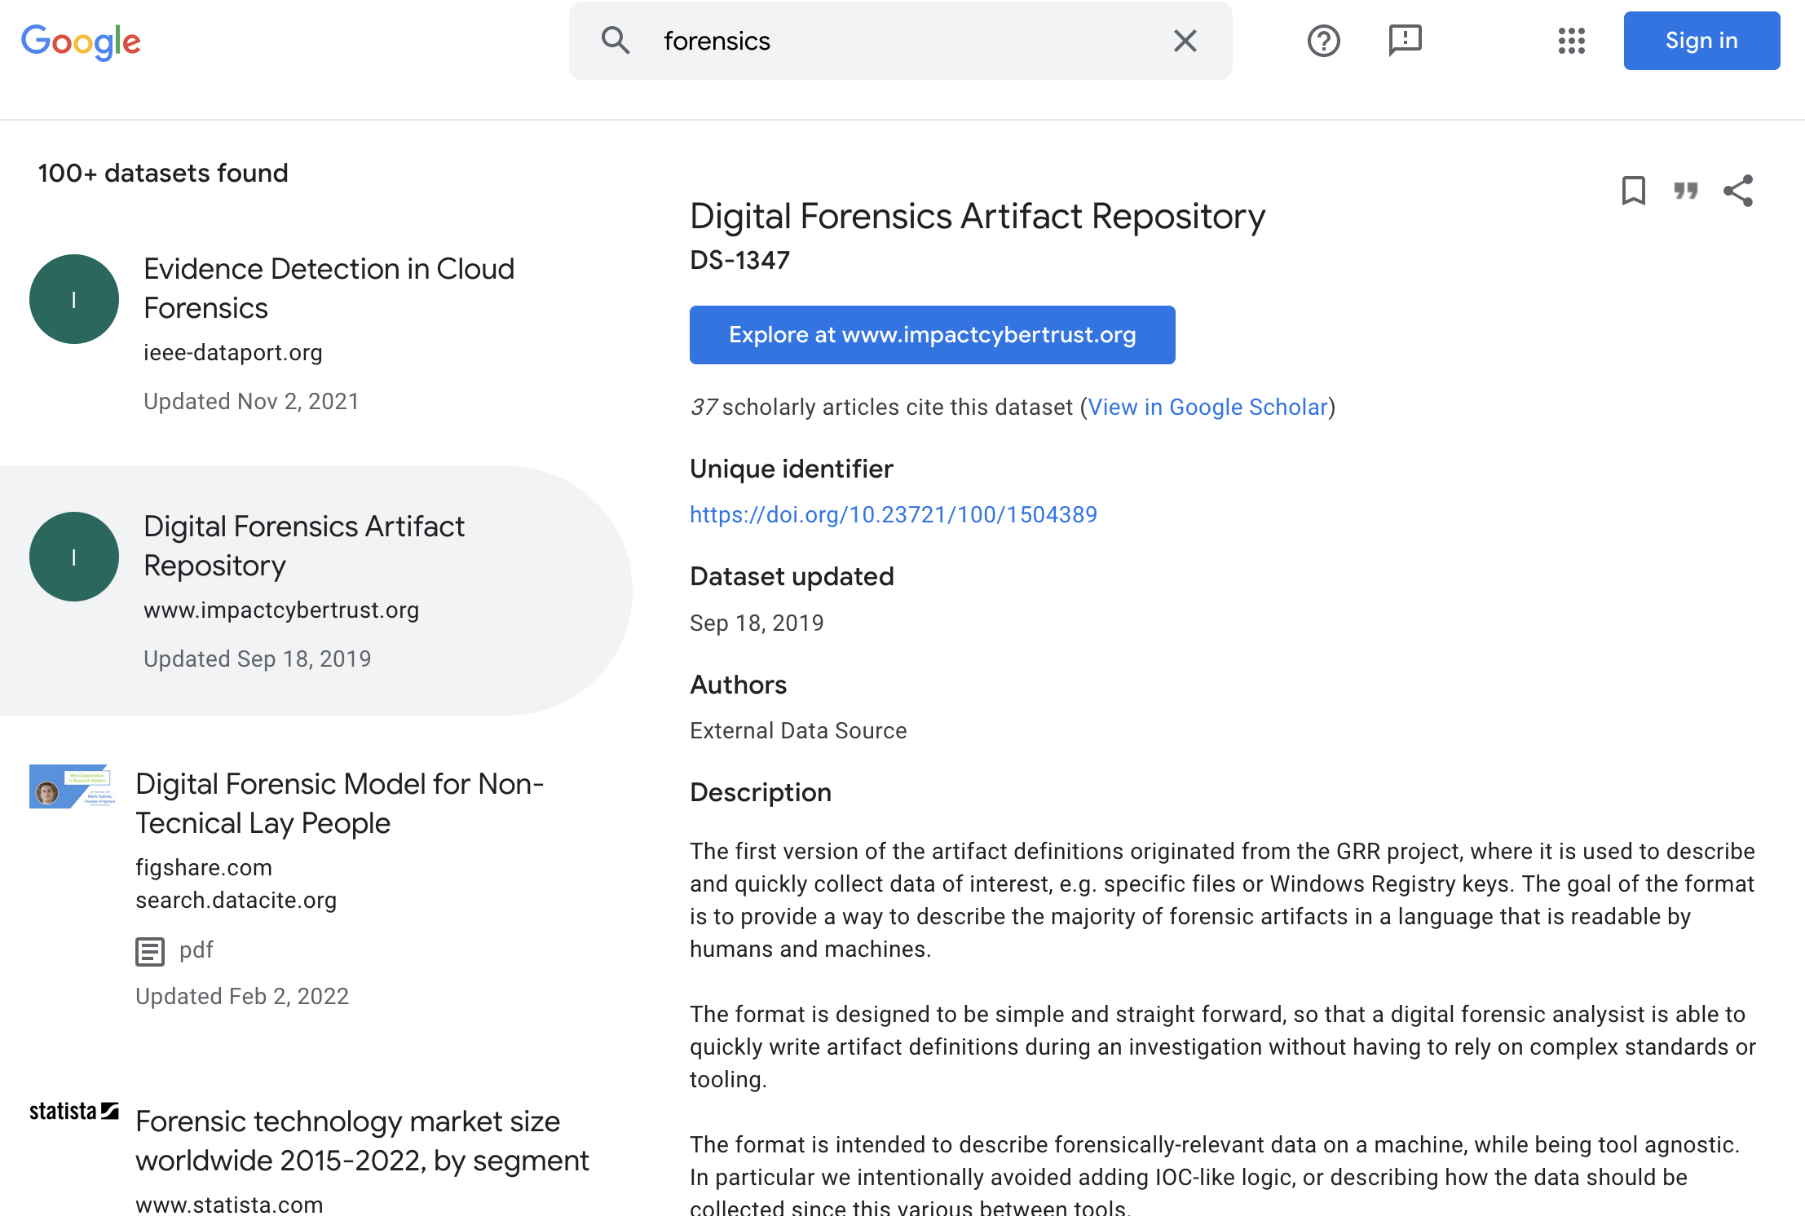

Slide 55
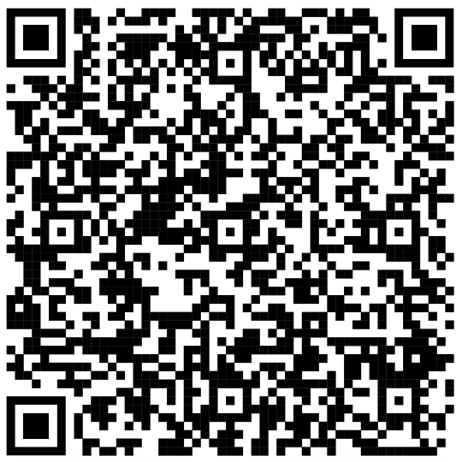
Noon Session
STEP-2:
Select a tool from the list QR-Coded Below!
Notes:
Show interactively

Slide 56
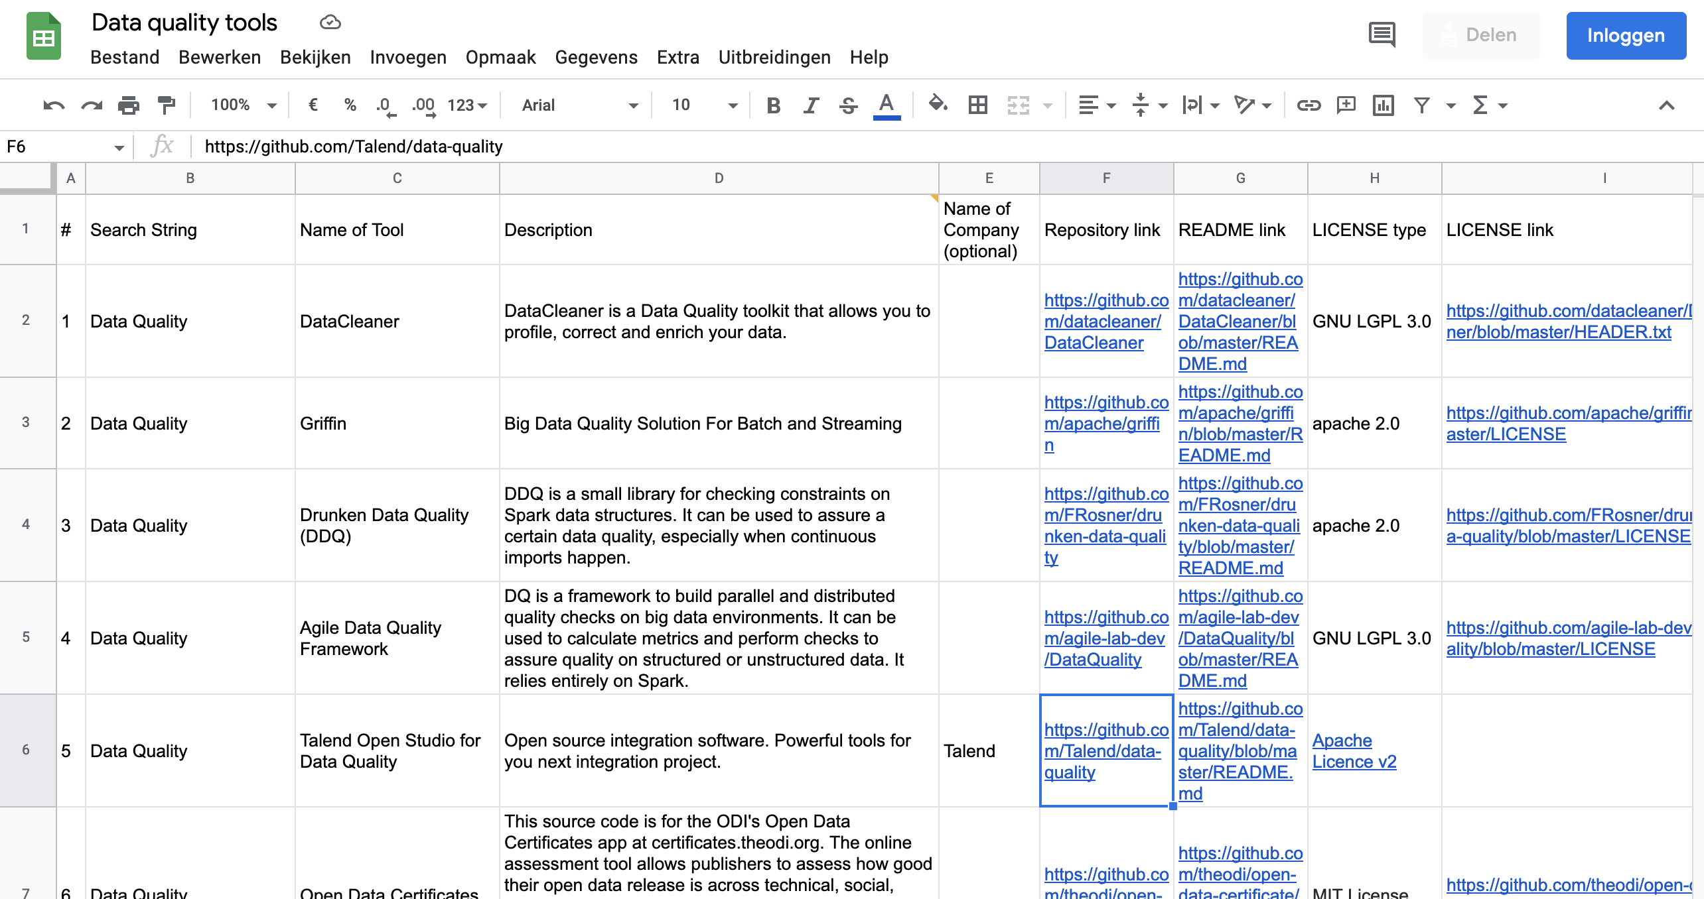

Slide 57
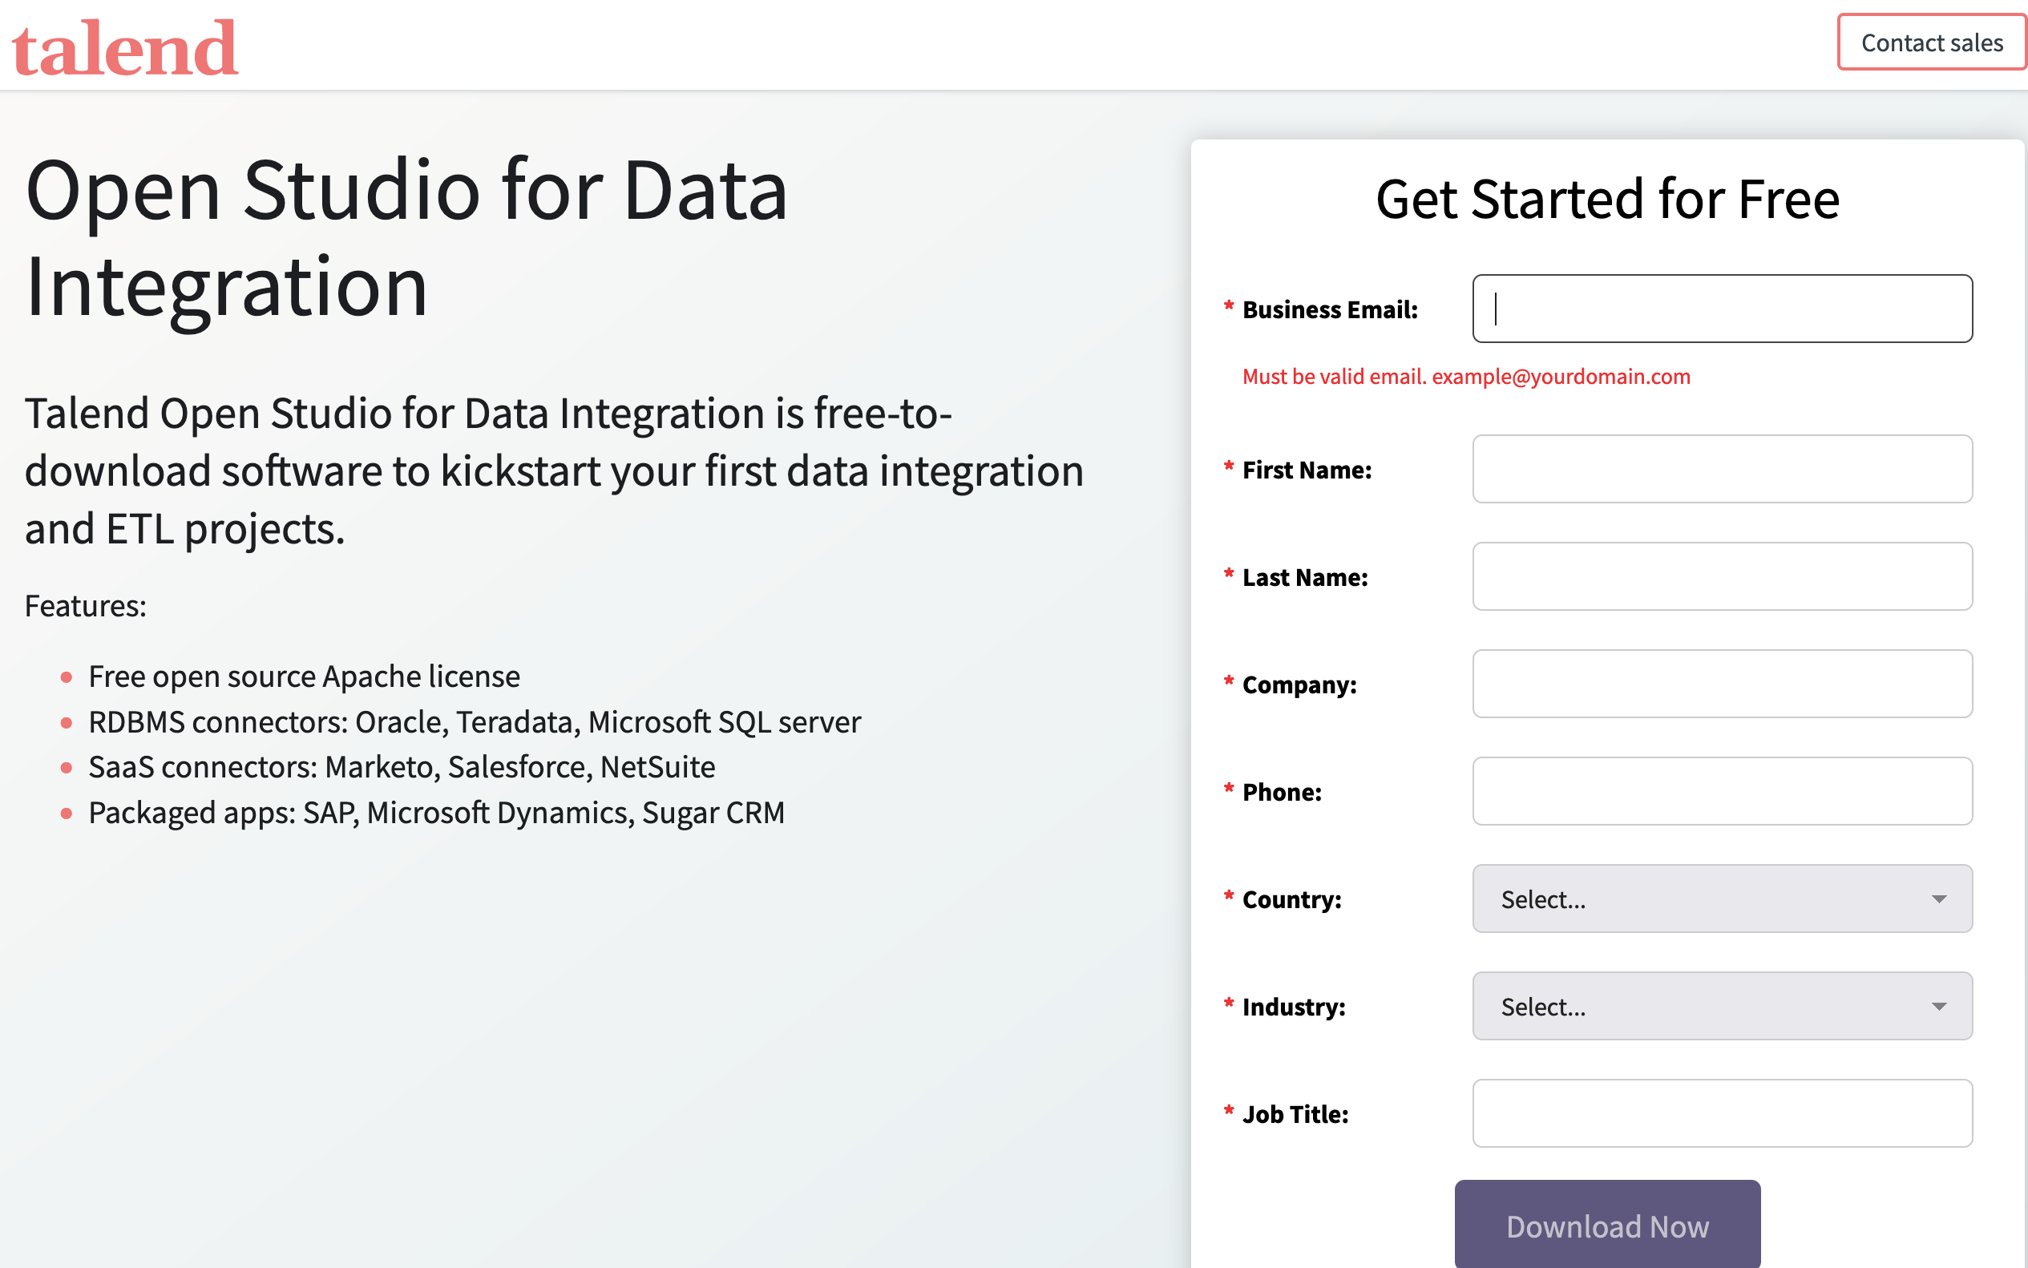

Slide 58
Noon Session
* Todo’s *
Find an online dataset here → https://datasetsearch.research.google.com/
Select a tool from the list in the QR-Coded link!
Extract data quality for your dataset!

Slide 59
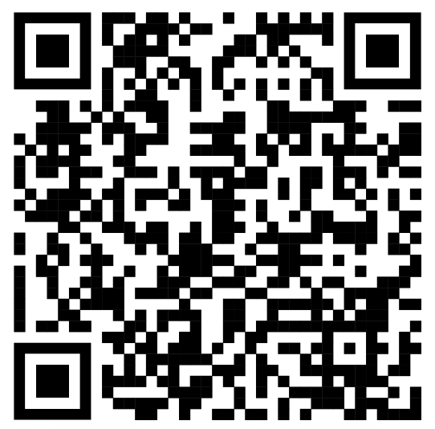
* Todo’s *
Find an online dataset here → https://datasetsearch.research.google.com/
Select a tool from the list in the QR-Coded link!
Extract data quality for your dataset!
Tell us about it! =>>>>>>>>>>>>

